Slide 1
AgriGreen 360 Funding
Presented By: Camila Avarez
5/13/2025

Slide 2
Executive Summary
AgriGreen 360 aims to transform U.S. agriculture with regenerative practices and smart farming tech.
Targets reversing soil degradation, reducing water use, and cutting carbon emissions across 100,000+ acres.
Implements composting, reduced tillage, crop diversity, and precision irrigation to restore soil and optimize resources.
Integrates AI-driven management, IoT sensors, and analytics for real-time farm optimization and input reduction.
Seeks 40% water savings and up to 30% reduction in chemical inputs by Year 4.
Focuses on workforce development, community engagement, and rural economic revitalization.
Establishes GreenField AgriCorp as a scalable, replicable model for national and global adoption.
Aligns with USDA and UN sustainability goals, ensuring measurable environmental and economic impact.

Slide 3
Agriculture
Agriculture is vital for food security, rural economies, and environmental health.
GreenField AgriCorp leads with 100,000+ acres, integrating regenerative practices and advanced agri-tech.
AgriGreen 360 initiative scales sustainable, tech-driven farming globally.
Smart farming tech (AI, sensors, precision irrigation) cut water use by 40%, boost input efficiency.
Regenerative and circular practices restore soil, increase biodiversity, divert 75% of waste from landfills.
Key challenges: soil degradation, water scarcity, climate volatility, and high adoption costs.
Droughts caused up to 20% yield loss in Midwest fields, highlighting need for resilience.
Solutions: pilot programs, workforce training, community engagement, and transparent data sharing.
Aligned with USDA, UN SDGs, and U.S. 2030 emissions targets for climate-smart agriculture.
AgriGreen 360 aims to set a replicable, scalable model for sustainable, profitable farming.

Slide 4
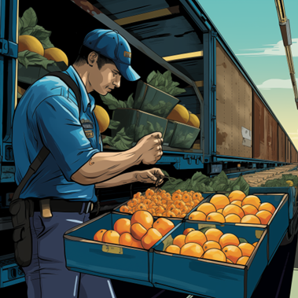
Market Demand
Strong, rising demand for sustainable, regenerative agri-products in domestic and global markets
Grains (corn, wheat, soybeans): 25% annual growth in regenerative contracts; 8–12% price premiums; major buyers securing multi-year deals
International demand up, especially EU/Asia; 30% forecasted growth as sustainability regulations tighten
Vegetables/fruits: $72M in 2024 retail sales, 17% YoY growth; 62% of consumers pay premium for eco-labels; price premiums 15–22%
Institutional sales (schools, hospitals): $18M in 2024; projected 40% growth over 5 years as sustainability criteria rise
Bioenergy crops: 350,000+ tons supplied; 10–14% price premium; demand to grow 12% annually through 2030, driven by policy
Premium/specialty markets: 6,000 tons organic produce sold at 25%+ premium; plant-based protein and digital traceability channels expanding
GreenField’s tech, traceability, and scale position it to capture and grow high-value, climate-smart market segments

Slide 5
Yield
Yield = key metric for productivity, food security, and resource efficiency
AgriGreen 360: boosts yield via regenerative practices & smart tech, reducing environmental impact
Yield links profitability, resource stewardship, and food supply; past intensification harmed soil & water
GreenField AgriCorp outperforms benchmarks: Corn 195 vs. 177, Wheat 74 vs. 65, Soybean 58 vs. 52 bushels/acre
Regenerative soil management: cover crops, compost, reduced tillage = 12-18% yield gains in pilots
Precision tech: AI, sensors, precision irrigation = 9% yield rise, 22% better water-use efficiency
Biodiversity: pollinator habitats, crop rotation, agroforestry = higher, more stable yields
Water innovations: drip irrigation, recycling prevent drought losses, stabilize output
Projected 5-year gains: Grains +10-15%, Veg/Fruit +8-12%, Bioenergy +10-18%; 25% less synthetic input, 40% less irrigation
Rigorous measurement & third-party audits ensure transparency, replicability
Yield is the foundation for sustainable, resilient, and profitable agriculture

Slide 6
Property
Over 100,000 acres of arable land owned, mainly in U.S. Midwest; all properties fully titled, mapped, and USDA-compliant
Three major processing centers and advanced R&D facility valued at $80M+; all facilities fully owned, insured, and maintained
No third-party liens or encumbrances on any property; assets freely deployable for project or funding match
11 active U.S. patents in precision agriculture; 2 pending patents for regenerative farming technologies
Proprietary FarmSight™ AI platform and exclusive, longitudinal agri-data sets drive innovation and benchmarking
Registered trademarks protect GreenField AgriCorp, AgriGreen 360, and FarmSight™ brands
Extensive fleet: 420+ tractors, 180 combines, 265 planters, 320+ irrigation systems—all modern, GPS-enabled, and fully owned
95 transport vehicles, 18 produce warehouses, 11 grain elevators, and robust cold chain assets ensure logistics capacity
Small heritage livestock herd supports ecological research and biodiversity goals
All financial accounts and reserves independently held, ensuring fiscal transparency and project control

Slide 7
Sustainability
Sustainability is core: ecological, economic, and operational goals integrated from start
Financial self-sufficiency via cost savings (25% less synthetic inputs, 40% less water by Year 5) and new revenue streams
Regenerative practices and precision tech cut costs, boost soil health, and reduce market risk
Revenue diversification through certified regenerative, climate-smart, and specialty crops; access to premium markets
Environmental gains: improved soil, water conservation, biodiversity, and circular resource use
Durable, upgradable equipment and tech; long-term service and training contracts
Ongoing workforce training, partnerships with local education, and strong community engagement
Transparent monitoring, annual sustainability reporting, and compliance with USDA/global standards
Pursuit of new grants, partnerships, and demonstration expansion for continued innovation
Scalable, replicable model with toolkits, workshops, and knowledge sharing
Dedicated innovation team ensures adaptability and future-readiness
AgriGreen 360 positioned as a national model for climate resilience and rural prosperity

Slide 8
Uses of Funds
$1.95M for precision ag tech: AI crop monitoring, IoT sensors, drip irrigation; targets 40% water, 25% fertilizer/pesticide reduction
$1.6M for regenerative ag: cover crops, composting, no-till, agroforestry; aims for 0.5% annual soil organic matter increase, lower emissions
$800K for workforce/community: training, job creation, rural engagement; builds skills for tech adoption and climate-smart practices
$400K for circular economy: waste processing, water recycling, zero-waste pilots; targets 90% organic waste diversion, cost savings
$250K for environmental monitoring: remote sensing, analytics, third-party audits; ensures transparent, data-driven impact tracking
$500K+ matching/in-kind: personnel, equipment, land; demonstrates commitment, meets federal cost-share
All investments align with USDA OSAD goals, drive innovation, and create a replicable, sustainable ag model

Slide 9
Return on Investment
5-year ROI analysis: $350K total costs vs. $545K total benefits
Net gain over 5 years: $195K; ROI: 56%
Initial year loss ($100K), positive net from year 2 onward
ROI grows from -67% (2025) to 200% (2029)
Startup costs recovered within a few years
Profits reinvested locally, supporting schools and small businesses
Non-financial benefits: organic food, pollination, education, recreation for community
Description | 2025 | 2026 | 2027 | 2028 | 2029 | Total
Total Costs | $150,000 | $50,000 | $50,000 | $50,000 | $50,000 | $350,000
Benefits | $50,000 | $90,000 | $120,000 | $135,000 | $150,000 | $545,000
Net | ($100,000) | $40,000 | $70,000 | $85,000 | $100,000 | $195,000
Ratio | -0.67 | 0.80 | 1.40 | 1.70 | 2.00 | 0.56
ROI | -67% | 80% | 140% | 170% | 200% | 56%

Slide 10
About Us
Founded 1985 in Lincoln, Nebraska; now global leader in sustainable agribusiness
Operates 100,000+ acres across North America, South America, and Europe
Mission: Feed the world responsibly, preserving resources for future generations
Pioneers in regenerative agriculture, precision tools, and smart farming technologies
Achieved double-digit gains in soil health, water retention, and biodiversity
Recognized for exceeding carbon reduction, water conservation, and rural development benchmarks
State-of-the-art production: GPS tractors, AI crop monitoring, IoT irrigation
Annual output supplies domestic and international markets; robust logistics network
Employs 2,000+ professionals; HQ in Lincoln, with major US and global offices
Committed to innovation, community growth, and sustainable food systems
Contact: Robin Wallace, Director, robin@greenfieldagricorp.com, 402-555-2323

Slide 11
Personnel
Multidisciplinary team with expertise in regenerative agriculture, agri-tech, sustainability, and project management
Jonathan Miller (CEO): 35+ years' leadership, pioneered precision ag, led 50,000-acre regenerative transition, launched FarmSight™
Dr. Priya Ramanathan (VP R&D): 20+ years' research, architect of AgriGreen 360, led USDA-funded studies, expert in soil health and carbon sequestration
Carlos Estevez (Director, Digital Ag): 18+ years' agri-engineering, deployed AI/IoT systems on 200,000+ acres, designed FarmSight™
Camila Alvarez (CFO): 15+ years' agribusiness finance, managed $40M+ in grants, developed ROI tracking and financial sustainability plans
Maya Sanchez (Sr. Manager, Community): 14 years' rural development, led training for 3,000+ producers, advanced workforce equity and inclusion
Team ensures innovation, compliance, measurable impact, and alignment with USDA OSAD goals
Combined experience guarantees project success, transparency, and scalable adoption nationwide

Slide 12
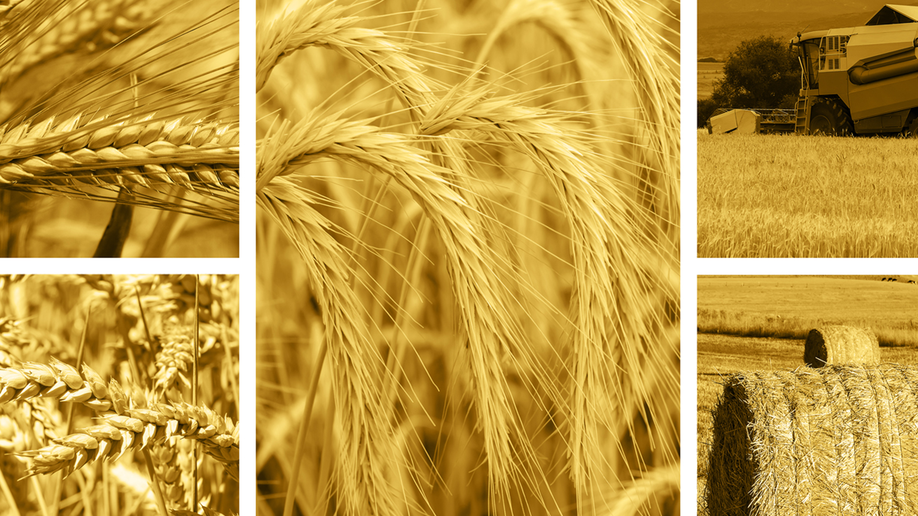
Greenfield Agricorp
2034 Suncrest Lane
Lincoln, Nebraska 68501
(PH) 402-555-2323
(FX) 402-555-1212
www.greenfieldagricorp.com
https://www.facebook.com/greenfieldagricorp
https://bsky.app/profile/greenfieldagricorp.bsky.social

