Slide 1
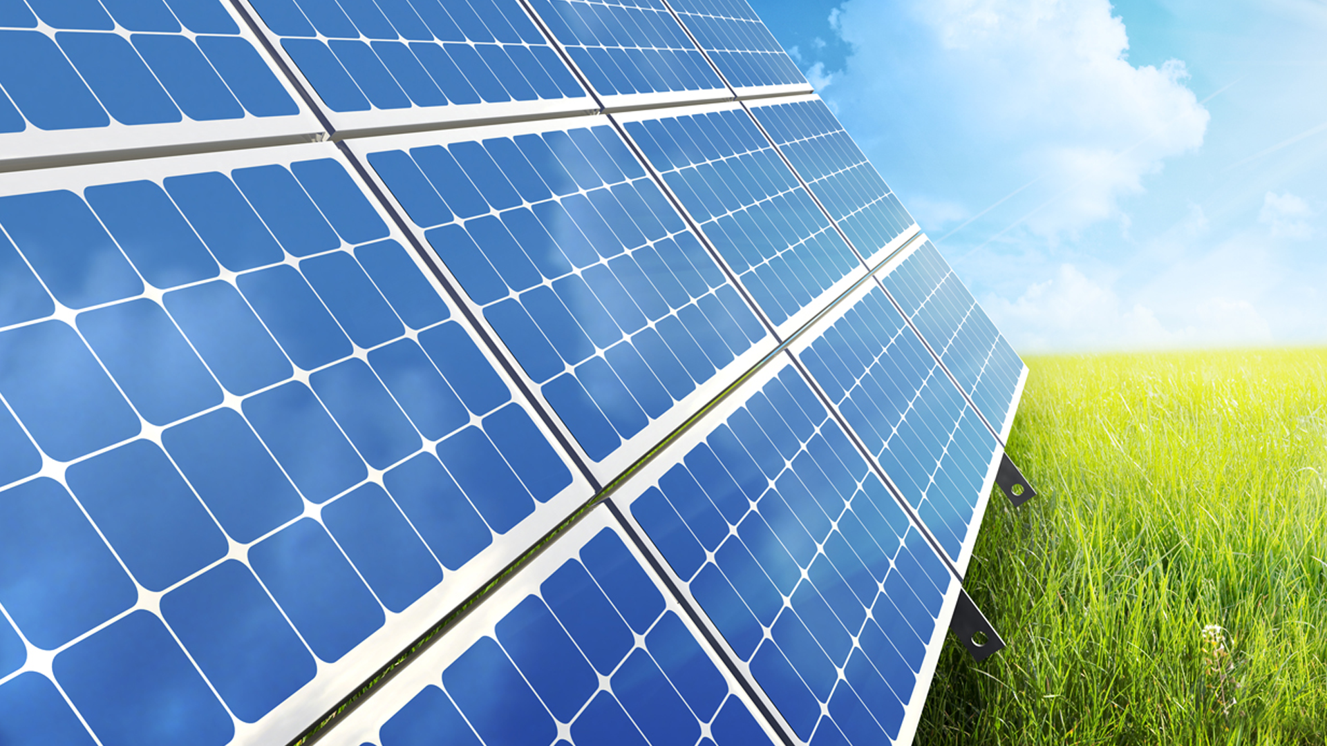
Green Community Case Study
Presented By: Lisa Jameson
5/28/2025

Slide 2
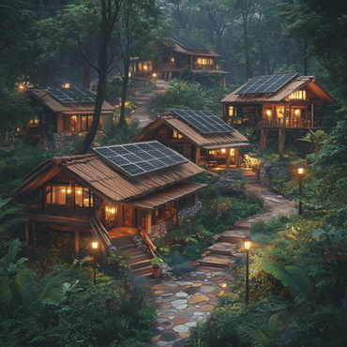
Present Situation
Built environment faces urgent need for sustainable, profitable development
Verdanz Partners leads mid-sized sustainable real estate, exemplified by Coyote Canyon
Coyote Canyon: 7 years of near-total grid independence, net energy producer
Water use cut to 25% of typical; advanced recycling, xeriscaping, wind-powered pumping
High resident satisfaction: lower costs, low maintenance, pride in sustainability
Industry trends: stricter codes, green incentives, demand for scalable eco-communities
Next-gen projects: more automation, adaptive tech, refined design for resilience
Verdanz delivers ROI: Coyote Canyon's investment repaid many times over
Ongoing needs: climate-specific solutions, improved aesthetics, noise reduction
Future: net-positive, resilient communities; premium value, lower risk, social impact

Slide 3
Project Background
Traditional development in Mallard County strained electricity and water resources.
Green County Pilot Program grant enabled a model for sustainable, resource-efficient community.
Most local communities lacked renewable energy, efficient infrastructure, and ecological integration.
High utility use, reliance on fossil fuels, and unsustainable landscaping were common issues.
Barriers included weak regulations, risk aversion, and limited expertise in sustainable design.
Verdanz Partners offered integrated expertise in architecture, engineering, and sustainability.
Coyote Canyon aimed for net-zero energy, resource conservation, and economic viability.
Project aligned with Verdanz's mission: environmental stewardship, economic and social responsibility.
Coyote Canyon serves as a scalable template for future sustainable developments.

Slide 4
Literature Review
Sustainable practices in real estate reduce costs, environmental impact, and boost resilience.
Kibert: Lifecycle cost benefits, context-sensitive green tech, stakeholder engagement key for success.
Turner & Frankel: LEED buildings use 25-35% less energy; post-occupancy evaluation vital for ROI.
Dunnett & Kingsbury: Green roofs must match local climate; proper design maximizes performance, comfort.
Brown: Community-scale renewables and water management drive resilience, utility savings, and property value.
Literature stresses climate-adapted methods, robust evaluation, and community participation.
Coyote Canyon case: Net-positive, integrated solutions prove financial and operational viability in harsh climates.
Verdanz Partners model: Continuous improvement, transparent reporting, and competitive advantage for mid-sized businesses.

Slide 5
Interviews
Resident interviews validate Coyote Canyon's eco-forward design and operational success.
Homeowners report pride in utility savings, environmental mission, and family impact.
Facilities manager confirms low-maintenance, reliable renewable systems; notes minor climate-driven challenges.
Long-term residents value energy self-sufficiency, low bills, and easy landscape upkeep; suggest more visual diversity in xeriscaping.
Younger residents highlight the community's "cool factor" and strong social appeal.
Interviews reveal high resident engagement, cross-generational pride, and collective ownership of sustainability.
Feedback informs ongoing design improvements and scalability for future projects.
Contact info available for further validation or follow-up.

Slide 6
Evaluation
Comprehensive evaluation plan ensures accountability, compliance, and industry leadership
Multi-phase data collection: pre-construction baselines, real-time monitoring, post-occupancy feedback
Baseline surveys capture energy, water, climate, ecology, and stakeholder expectations
Automated systems and manual audits track energy, water, renewables, waste, and resident satisfaction
Data analysis combines quantitative metrics with qualitative insights for actionable conclusions
Performance measured against pre-construction, regional, and industry benchmarks
Key targets: 40%+ grid electricity reduction, net-positive energy, 75%+ water savings, 95%+ system uptime
Resident satisfaction goal: 85%+ report comfort, savings, and amenities satisfaction
Transparent biannual reports with data visualizations and strategic recommendations
Evaluation drives continuous improvement, knowledge sharing, and scalable sustainability solutions

Slide 7
Analysis
Rigorous analysis validated sustainable design, guided optimization, and demonstrated accountability.
Focused on real-world performance of green roofs, skylights, solar/wind power, xeriscape, and water systems.
Measured reductions in utility use, costs, and environmental impact; included user experience and community engagement.
Multidisciplinary team led by certified experts ensured technical rigor and stakeholder input.
Methodology: baseline data, advanced monitoring, phased reviews, and benchmarking against standards.
Results: 45% cut in heating/cooling costs, 40% drop in lighting energy, near self-sufficiency in electricity, water use at 25% of regional average.
Financial savings recouped initial investments multiple times; strong case for sustainable design ROI.
Identified operational challenges led to adaptive solutions and design improvements.
High resident satisfaction, increased property values, and community advocacy for sustainability.
Analysis proves operational, financial, and reputational benefits for mid-sized business clients.

Slide 8
Data
Data grouped into operational, environmental, financial, and qualitative categories for comprehensive analysis
Energy data: smart meters track usage, renewable output logged; 40% reduction in external energy reliance achieved
Surplus renewable energy sold back to grid, confirming net-positive status and scalability
Water use: monthly tracking shows 75% less consumption than regional average; detailed irrigation and treatment analytics
Climate adaptation: sensors monitor green roofs, skylight efficiency; data informs design improvements
Financial impact: utility savings, ROI, and payback periods calculated; property values and demand tracked
User satisfaction: resident and manager surveys assess comfort, savings, and quality of life; community engagement measured
Operational challenges: incident logs and post-occupancy evaluations drive continuous improvement
Data-driven approach ensures transparency, accountability, and confidence for investors and stakeholders

Slide 9
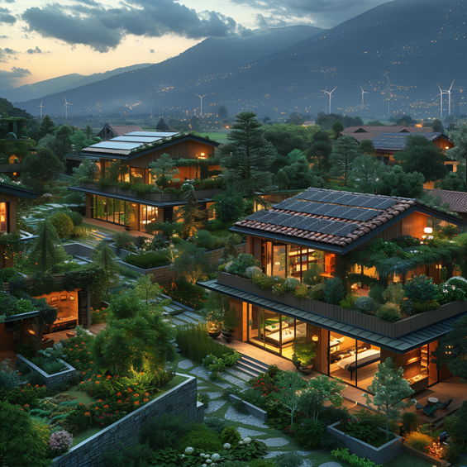
Data
Data grouped into operational, environmental, financial, and qualitative categories for comprehensive analysis
Energy data: smart meters track usage, renewable output logged; 40% reduction in external energy reliance achieved
Surplus renewable energy sold back to grid, confirming net-positive status and scalability
Water use: monthly tracking shows 75% less consumption than regional average; detailed irrigation and treatment analytics
Climate adaptation: sensors monitor green roofs, skylight efficiency; data informs design improvements
Financial impact: utility savings, ROI, and payback periods calculated; property values and demand tracked
User satisfaction: resident and manager surveys assess comfort, savings, and quality of life; community engagement measured
Operational challenges: incident logs and post-occupancy evaluations drive continuous improvement
Data-driven approach ensures transparency, accountability, and confidence for investors and stakeholders

Slide 10
Statistics
90% reduction in electricity use vs. county average; 100% supplied by onsite renewables
75% lower water consumption per home; advanced recycling and xeriscaping
35% reduction in maintenance costs; efficient landscaping and resident engagement
12% surplus renewable energy sold back to grid; new revenue stream for residents
Homes sell at 10-15% premium; persistent buyer waitlist
Annual utility savings of $1,800 per home; grant payback in under 3 years
27% annual ROI for community; strong financial and environmental performance
All results third-party verified; data supports Verdanz as a market leader in sustainable development

Slide 11
Statistics
90% reduction in electricity use vs. county average; 100% supplied by onsite renewables
75% lower water consumption per home; advanced recycling and xeriscaping
35% reduction in maintenance costs; efficient landscaping and resident engagement
12% surplus renewable energy sold back to grid; new revenue stream for residents
Homes sell at 10-15% premium; persistent buyer waitlist
Annual utility savings of $1,800 per home; grant payback in under 3 years
27% annual ROI for community; strong financial and environmental performance
All results third-party verified; data supports Verdanz as a market leader in sustainable development
Performance Category | Coyote Canyon Value | County Average | Improvement (%)
Electricity Consumption (kWh/home/year) | Net-Zero (100% renewable) | ~10,000 | 100% reduction in grid use
Water Consumption (gallons/home/month) | 2,500 | 10,000 | 75% reduction
Property Value Premium | +10-15% | Baseline | Market-leading
Annual Utility Savings (per home) | $1,800 | $0 (baseline) | N/A
Maintenance Cost Reduction | 35% lower | Baseline | Substantial

Slide 12
Lessons Learned
Green roofs must be climate-adapted; increase substrate depth for drought resilience and long-term performance.
Daylighting requires dynamic shading controls in hot climates to balance energy savings and occupant comfort.
Automated controls are essential for wind-powered water systems to prevent operational risks and resource waste.
Design must address both function and sensory experience; enhance aesthetics and reduce noise for resident satisfaction.
Operational flexibility and active resident engagement drive project adaptability and long-term success.
Continuous improvement, feedback, and training are vital for resilient, high-value sustainable communities.
Climate-responsive, integrated, and holistic planning is key to risk management and asset value.

Slide 13
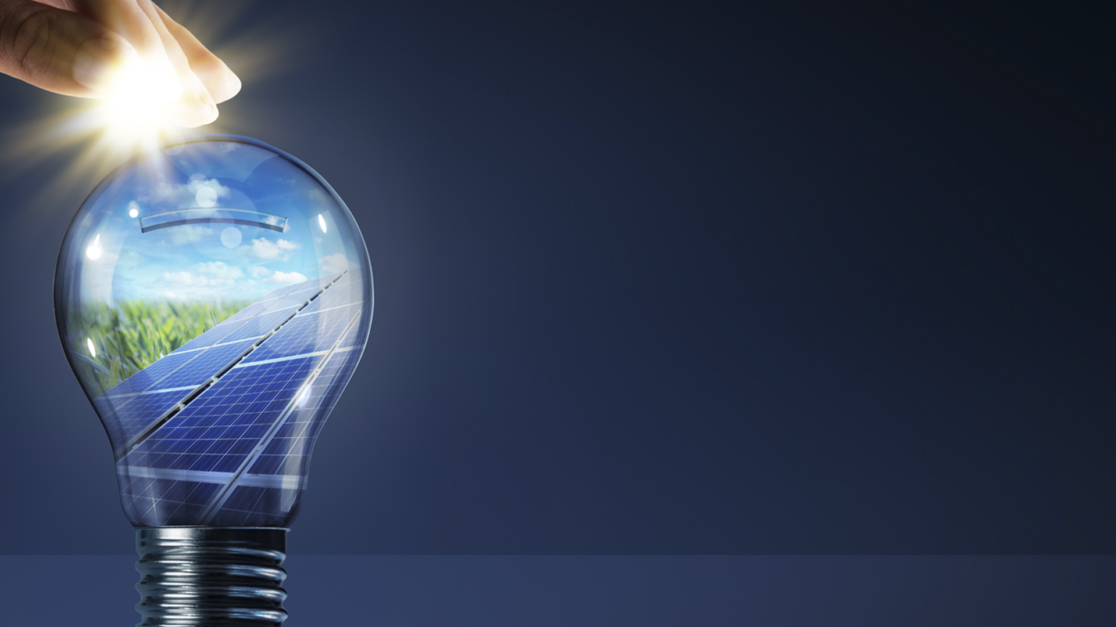
Verdanz Partners
P.O. Box 304
Austin, TX 73301
(PH) 555-555-3954
www.VerdanzPartners.net

