Slide 1
HVAC Installation
Presented By: Ian Lauder
5/14/2025

Slide 2
Introduction
Wellness leader in Redmond
Precise climate control essential
Custom HVAC for hot yoga
Advanced, efficient technology
HeatMaster 3000 system
Smart zoning, thermostats
ROI: cost savings, reliability
Expert installation, 24/7 support

Slide 3
Executive Summary
Custom HVAC for wellness studio
Precise temperature and humidity control
Rapid heating, responsive scheduling
Superior air quality, filtration
Energy efficiency, cost reduction
Sustainable, eco-friendly practices
Professional installation, staff training
Long-term comfort and reliability

Slide 4
Efficiency
High-output radiant heating
Consistent temperature, less cycling
Lower energy and operating costs
Smart multi-zone climate control
Automated, occupancy-based programming
Efficient humidity, air quality control
Commercial-grade, low-maintenance design
99.9% uptime, minimal downtime

Slide 5
Eco-Friendly
High-efficiency heating system
Smart thermostats optimize use
Lower energy, reduced emissions
Advanced air filtration & UV-C
Recyclable, sustainable filters
Eco-friendly sourcing & packaging
Reduced waste, responsible disposal
Supports wellness & community leadership

Slide 6
Services Provided
Custom HVAC design consulting
Professional installation & integration
System commissioning & verification
Preventive maintenance plans
24/7 emergency repair service

Slide 7
Products
High-efficiency heating system
Rapid, precise temperature control
Continuous duty for busy studios
Industry-leading reliability, low noise
Smart thermostats, multi-zone control
Real-time monitoring, remote access
Energy savings, reduced downtime
Enhanced client comfort, satisfaction

Slide 8
Installation Details
Site cleared, permits secured
Class downtime scheduled
Electrical supply reviewed/upgraded
Advance notifications posted
Equipment staged, floors protected
Panels, wiring, thermostats installed
Code-compliant connections ensured
Safety protocols strictly followed
System tested, calibrated, approved
Staff trained, manuals provided
Thorough cleanup, walkthrough done
Maintenance schedule established

Slide 9
Maintenance Plan
Quarterly HVAC inspections
Smart controls calibration
Filter & humidifier service
UV lamp annual check
Proactive failure prevention
Minimized business disruption
24/7 emergency support
Detailed service records

Slide 10
Cost Summary
HeatMaster 3000: $5,000
Installation Kit: $200
Thermostats (2): $400
Product Subtotal: $5,600
Installation Service: $1,440
Service Subtotal: $1,440
Combined Subtotal: $7,040
Discount: $100
Tax Rate: 8%
Sales Tax: $555.20
Total: $7,495.20
Estimate only, not final
Products
Description | Price | Quantity | Amount
HeatMaster 3000 | $5,000.00 | 1 | $5,000.00
Installation Kit | $200.00 | 1 | $200.00
Thermostat | $200.00 | 2 | $400.00
Subtotal |  |  | $5,600.00

Slide 11
Cost Summary
HeatMaster 3000: $5,000
Installation Kit: $200
Thermostats (2): $400
Product Subtotal: $5,600
Installation Service: $1,440
Service Subtotal: $1,440
Combined Subtotal: $7,040
Discount: $100
Tax Rate: 8%
Sales Tax: $555.20
Total: $7,495.20
Estimate only, not final
Services
Description | Rate | Hours | Amount
Installation | $60.00 | 24 | $1,440.00
Subtotal |  |  | $1,440.00

Slide 12
Cost Summary
HeatMaster 3000: $5,000
Installation Kit: $200
Thermostats (2): $400
Product Subtotal: $5,600
Installation Service: $1,440
Service Subtotal: $1,440
Combined Subtotal: $7,040
Discount: $100
Tax Rate: 8%
Sales Tax: $555.20
Total: $7,495.20
Estimate only, not final
Summary
Subtotal | $7,040.00
Discount | $100.00
Tax Rate | 8.00%
Sales Tax | $555.20
Total Amount | $7,495.20

Slide 13
Company History
Trusted HVAC leader, specialty focus
Environmental responsibility, customer-centric
Innovative, energy-efficient solutions
Custom, smart automation systems
Advanced tech: IoT, radiant, ERV
Premium equipment, rapid installation
Top manufacturer partnerships
Founded 2012, Seattle HQ
20 expert staff, certified team
Pacific Northwest service coverage

Slide 14
Experience
Specialty studio HVAC expertise
Over 40 wellness installations
Precision thermal, humidity control
Energy-efficient small business solutions
Advanced automation, zoning controls
Sustainable, eco-friendly practices
Preventive maintenance, ongoing support
Regulatory compliance, safety focus

Slide 15
Testimonials
Custom HVAC solutions delivered
Consistent comfort, air quality
Expertise in wellness environments
Smart controls, easy operation
Lower operating costs achieved
Professional, detailed service
Improved client retention, reviews
Guidance from design to training

Slide 16
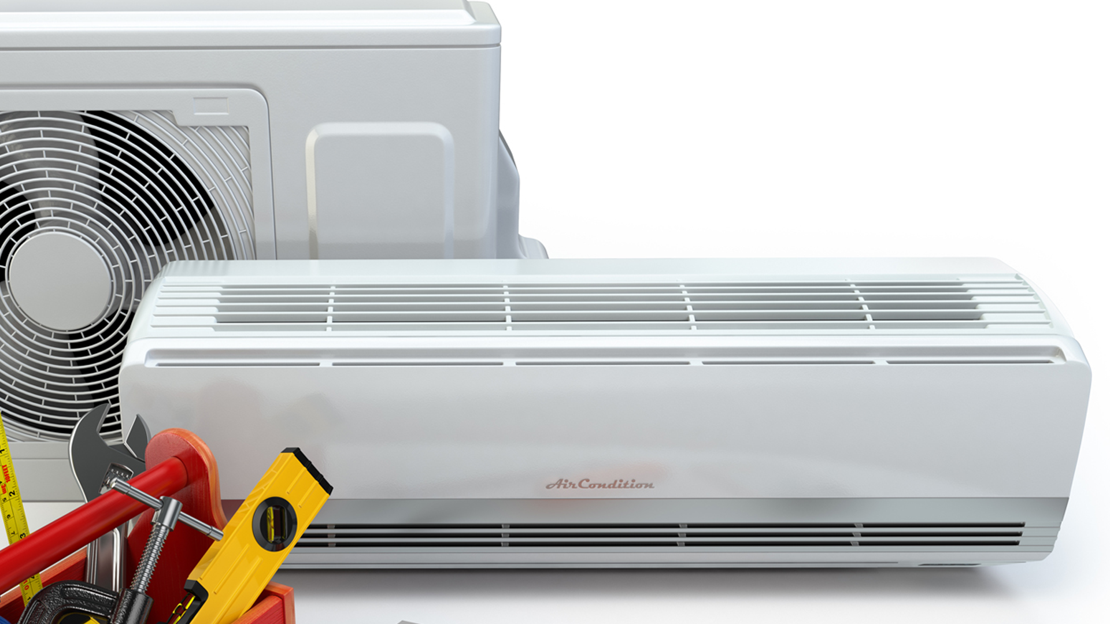
Envirosmart
1220 Evergreen Ave
Suite 250
Everett, WA 98203
(PH) 206-666-6666
(FX) 206-555-5555
www.envirosmart.com
https://www.facebook.com/EnviroHVAC
https://x.com/EnviroHVAC

