Slide 1
Facilities Security Plan
Presented By: James Thompson
5/19/2025

Slide 2
Introduction
High-tech manufacturing leader
Multi-site security challenges
Protect critical production zones
AI-driven surveillance & detection
Standardized access management
Emergency preparedness protocols
Cyber-physical system integration
Phased, scalable implementation
Expertise in compliance & training
Proposal: objectives, plan, ROI

Slide 3
Needs Assessment
Critical security gaps identified
High-value assets at risk
Regulatory compliance unmet
Unified, scalable security needed
AI-driven surveillance analytics
Centralized command dashboard
Layered physical security
Continuous training & audits
Phased, risk-based deployment
Significant ROI, reduced downtime

Slide 4
Goals and Objectives
Protect critical production zones
Layered access controls deployed
Perimeter intrusion detection
Quarterly breach simulations
AI video analytics rollout
Automated anomaly alerts
Security staff analytics training
Centralized monitoring platform
Unified incident response
Regular compliance audits
Ongoing risk assessments
Annual security reviews

Slide 5
Security Plan
Personnel vetting & screening
Role-based access approvals
Multi-factor physical controls
Real-time access monitoring
AI-driven surveillance analytics
End-to-end data encryption
Redundant off-site backups
Continuous compliance audits

Slide 6
Site Preparation
Stakeholder walkthroughs, site survey
Map utilities, assess infrastructure
Plan power, network upgrades
Coordinate with contractors, IT
Staging areas, logistics planning
Inventory, delivery, access protocols
Safety, compliance, permit checks
Badge, escort, credential scheduling

Slide 7
Risk Analysis
Key risk areas identified
Complex integration challenges
Operational disruption threats
Regulatory compliance risks
Proactive mitigation strategies
Contingency plans established
Continuous monitoring & review
Stakeholder confidence maintained

Slide 8
Contingency Planning
Critical hardware failure risks
Spare parts inventory readiness
Power and maintenance safeguards
Rapid device hot-swap protocols
Network outage contingency plans
Redundant connectivity solutions
Edge processing for outages
Data loss and corruption risks
RAID, backup, and cloud storage
Strict access and audit controls
Automated backup verification
Incident response and recovery

Slide 9
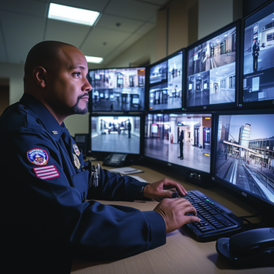
Site Security
Protect high-value assets, staff
Layered physical, tech, personnel controls
NIST, ITAR-compliant security framework
Perimeter fencing, gates, man-traps
24/7 access control, authentication
Visitor vetting, digital badge system
AI surveillance, intrusion detection
Automated alerts, 180-day log retention
Emergency lockdown, evacuation drills
Phased rollout, minimal disruption
Quarterly reviews, tech upgrades
Integrated with cyber-physical security

Slide 10
Vulnerabilities
Critical perimeter sensor gaps
Low-light perimeter vulnerabilities
Single-factor access risks
Tailgating and audit trail gaps
Surveillance blind spots
Delayed incident notifications
AI-driven security upgrades needed
Urgent remediation and approval deadlines

Slide 11
Dangers
Comprehensive risk evaluation needed
Chemical/material hazards in labs
Cleanroom contamination threats
Robotic system safety risks
Data center fire/overheating
Insider threats/IP sabotage
Regulatory/geopolitical compliance risks
Prioritize mitigation, cross-functional review

Slide 12
Security Controls
Defense-in-depth strategy
Multi-factor access controls
AI-driven surveillance analytics
Integrated intrusion detection
End-to-end data encryption
Emergency lockdown protocols
Visitor management workflows
Centralized command integration

Slide 13
Evaluation
Comprehensive evaluation plan
Performance vs. benchmarks
Continuous data collection
Real-time monitoring & audits
Trend and anomaly analysis
Regulatory compliance focus
User satisfaction measured
Transparent executive reporting

Slide 14
Policies
Data encrypted, access restricted
Personnel background checks, training
ITAR, NIST, export compliance
Incident detection, rapid response
Service terms, 12-month warranty
Scheduled updates, security audits
24/7 support, four-hour response
Annual policy review, amendments

Slide 15
SecureTech Solutions
3400 Innovation Drive
Suite 400
Portland, OR 97209
(PH) (555) 328-7246
www.securetechsolutions.com

